Slide 1




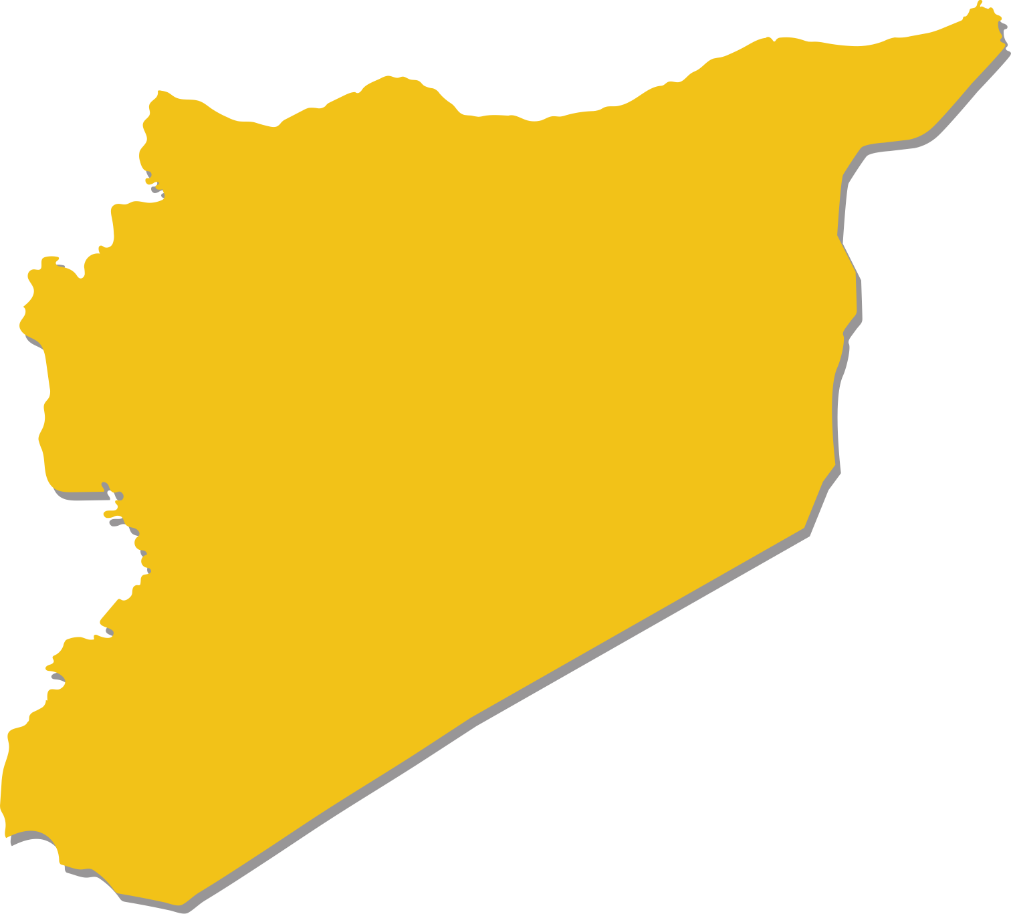








SYRIA • CONFLICT
September 2021
The ETC in Syria
is providing Internet connectivity & security
communications services to:
Gaziantep
Sanliurfa
Services provided in
13
COMMON
OPERATIONAL
AREAS
Al Qamishli
Kilis
Antakya
Aleppo
Raqqa
500
RESPONDERS
Deir Ez-Zor
100% funded
out of the
required budget of
US$429,405
in 2021
Hama
Tartous
Al Mukalla
14
UNITED
NATIONS
AGENCIES
1
INTER-GOVERNMENTAL AGENCY
Homs
Beirut
Damascus
6
SECURITY OPERATION CENTRES (SOC)
supported by the ETC
AUGUST – SEPTEMBER 2021
6 out of 6
SOCs installed with solar power systems to support security communications services
Dar’a
Amman
Locations with operational ETC services
ETC in Syria was
activated in
JANUARY 2013
16 VHF radios programmed
remotely for the UN Relief and Works Agency (UNRWA)
Locations with planned ETC services
Partner organizations supporting the ETC in Syria: OCHA, UNDSS, UNHCR, UNICEF, WFP
Syria.ETC@wfp.org | www.etcluster.org/emergencies/syria-conflict

